Slide 1
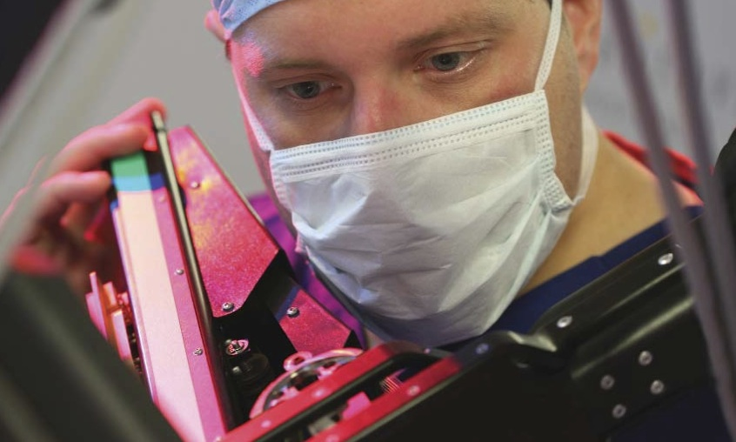
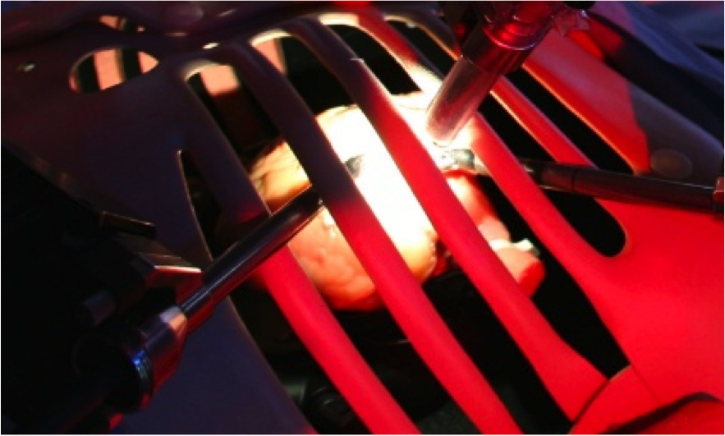

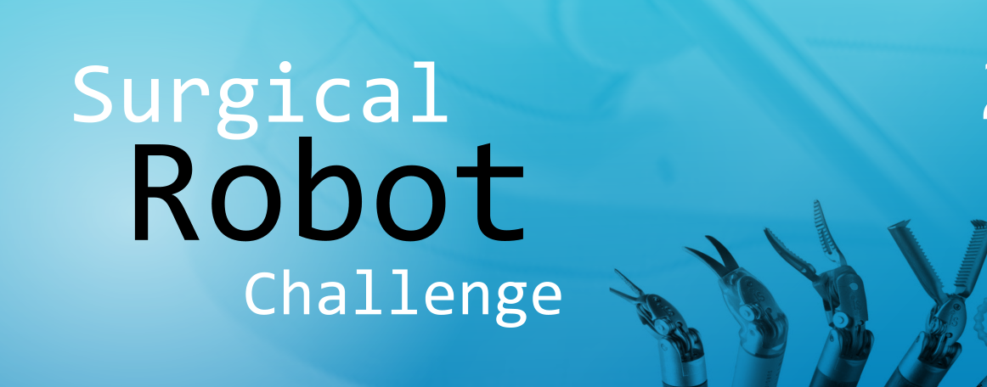
MASTER CONTROLLER WITH SHARED CONTROL FOR A CONTINUUM ROBOT
Shen Treratanakulchai
Supervisor
Prof. Guang-Zhong, Yang

Slide 2
Outline
Introduction
Literature Review
Material & Methods
Preliminary Study
Gantt Chart

Slide 3
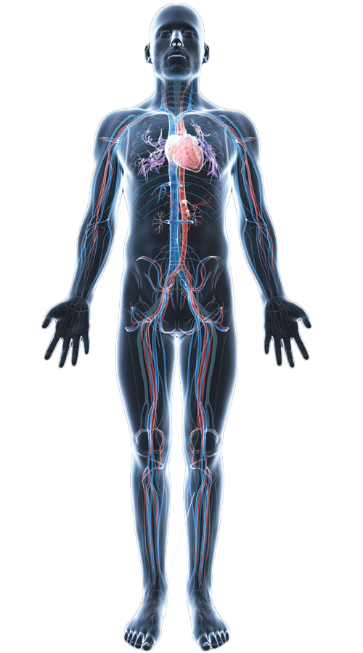
Introduction
Minimally Invasive Surgery
Natural Orifice Transluminal Endoscopic Surgery (NOTES)
Small/ No incision
Less trauma + Fast recovery
Less Infection
Constrain
Confined workspace
Small and highly flexible Instrument only
Surgical Remotely
Transoral Surgery
Transnasal Surgery
Cardiovascular Surgery
Transumbrical Surgery
Colorectal cancer is 1/3 of commonly cancer ^{[1]} US: ~51,000 Persons oral cavity cancer with estimated 10,000 deaths in 2018^{[2]}
Transluminal Surgery
[1] J. Shang et al., “A Single-Port Robotic System for Transanal Microsurgery—Design and Validation,” IEEE Robotics and Automation Letters, vol. 2, no. 3, pp. 1510–1517, 2017
[2] US National Cancer Institue
https://www.kisspng.com/png-muscle-human-body-anatomy-homo-sapiens-omega-3-fat-721162/preview.html

Slide 4
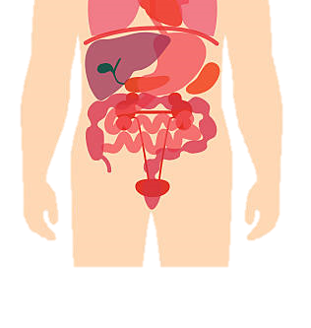
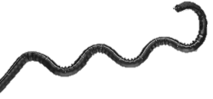
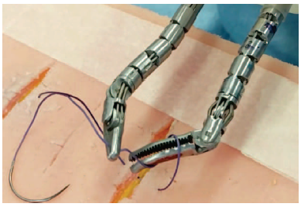
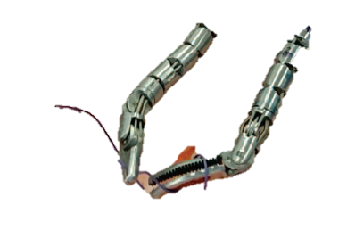
Introduction(cont.)
Continuum Robot
Flexible shape instrument (Snake-like robot)
Replacing Rigid-endoscope instrument
Allow navigation & surgery in confined space
Bi-Manual manipulation
Master/Slave Teleoperation
High redundant DOFs
Instrument
Main Body

Slide 5
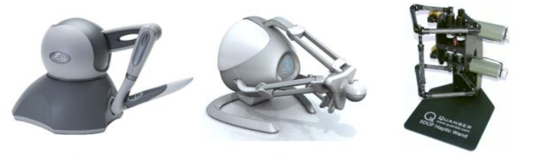
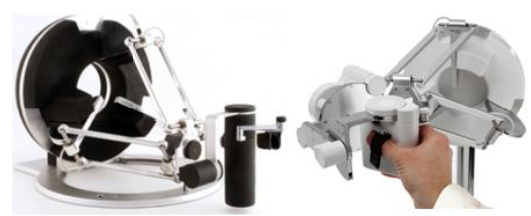
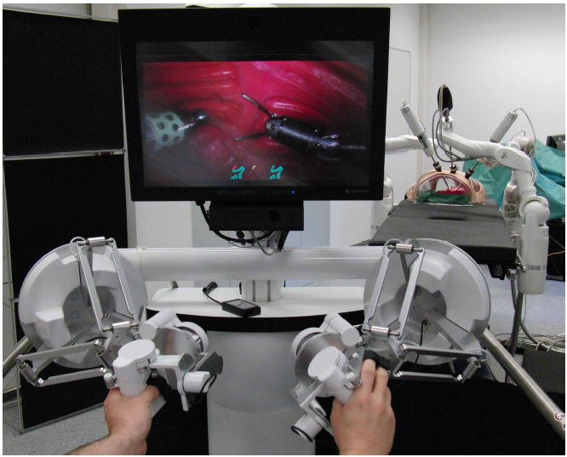
Introduction(cont.)
Available Master Controller
Master-Slave Teleoperation system
End-effector(Tip) pose control
Haptic sensation feedback

Slide 6
Introduction (cont.)
Limitations of the commercial master device for a continuum robot
No intermediate Joint Shape Control
Main robot control and instrument control are controlled separately
Lack of sense of touch for object manipulation and intermediate joint compliance
The mismatch kinematic in master/slave teleoperation system
Different number degree of freedoms (Master:LowDOF -> Slave:HighDOF)
Workspace mismatch -> Required Clutching
Commercial available device have not developed for the continuum robots
Hand-Eye Coordination Problems

Slide 7
Introduction (cont.)
Objectives
To develop the master controller for a continuum surgical robot more intuitive
To develop a master controller with shared control architecture
To develop master controller as a haptic device with transparency properties.
To control the slave robot with smooth movement and provide maximum exert force in particular direction using the auxiliary algorithm
Expected Results
Intuitive device for continuum robot control by design and assistive algorithm
Realistic haptic feedback providing for the NOTES application in shared control architecture

Slide 8
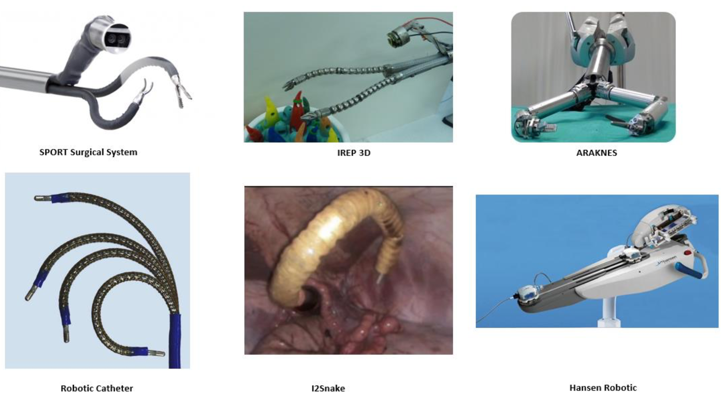
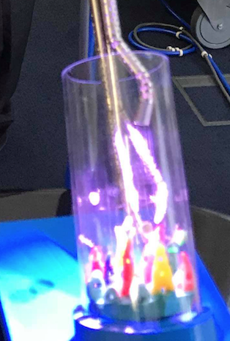
Literature Reviews
Surgical Robot In NOTES
Tendon driven based
No external force sensing
Concentric Tube
Precurvature and length
Instrumentation- visualization and Surgical integration
da Vinci Xi

Slide 9
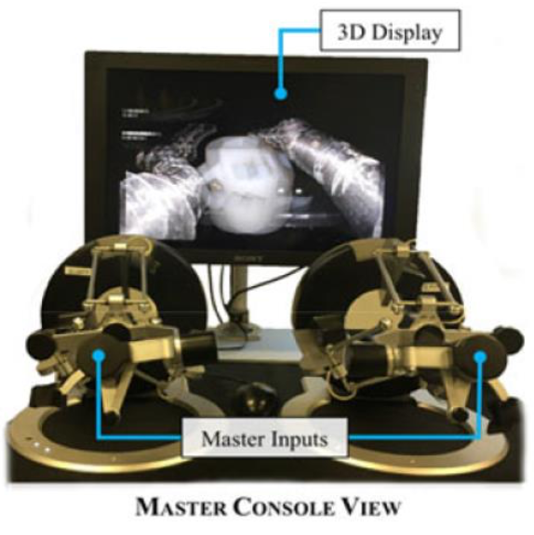
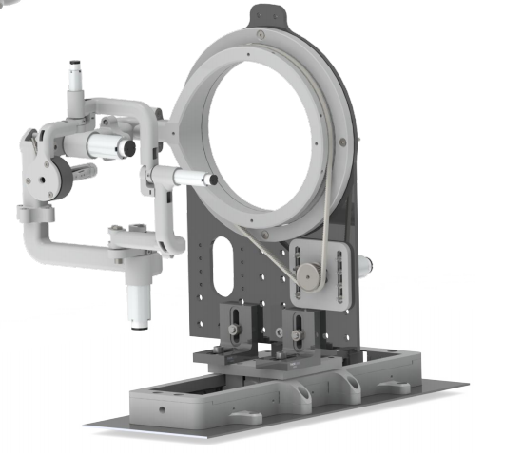
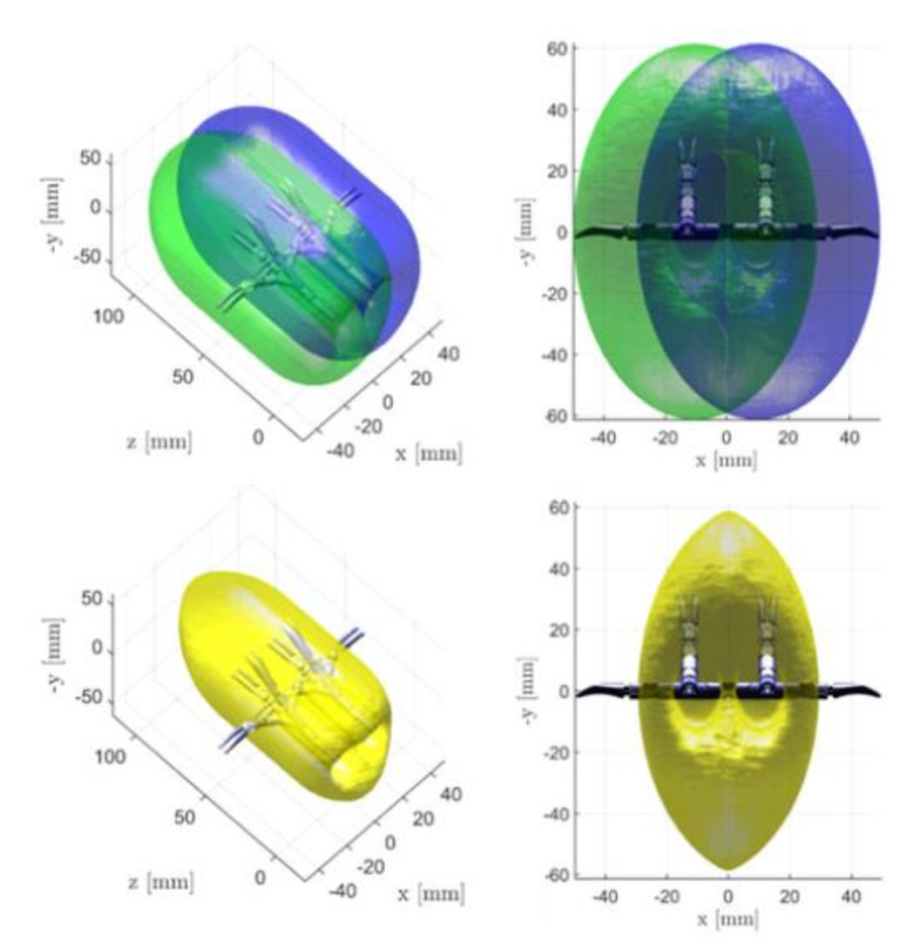
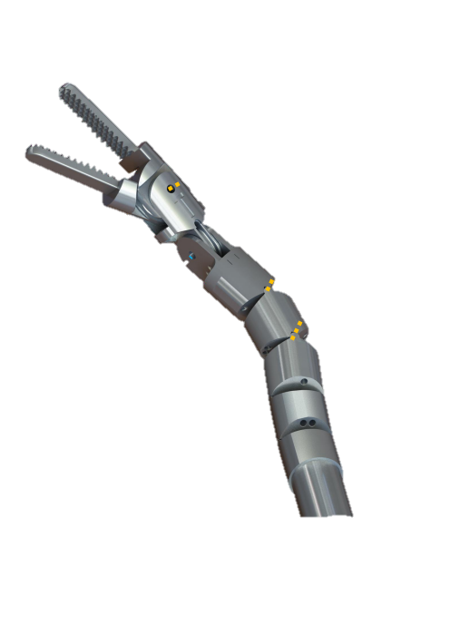
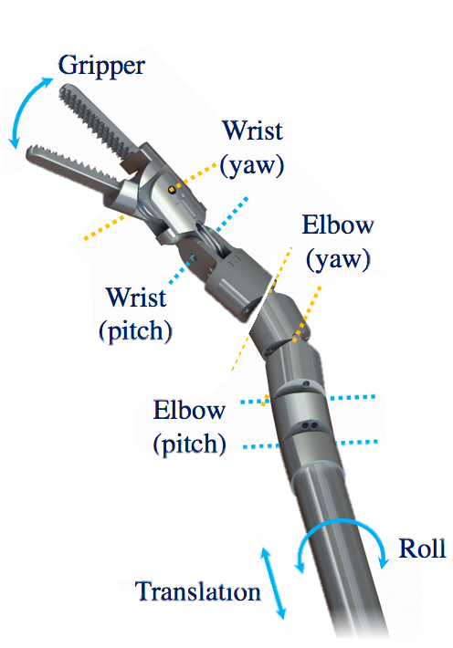
Literature Reviews(cont.)
Hamlyn Centre Previous Works
Micro-IGES robot system for TEMS
Rectum Surgery
Joint Mapping Controller
Parallel Master Controller (Omega 7)
 | Joint Mapping Controller (Piyamate's design) | Parallel Master Controller (Omega 7)
Maximum lateral Force | 5N | 12 N
Inertia | High | Low
Dynamics (Force/Velocity) | Low | High
Kinematic | -Similar to a slave robot -FWD Kinematic: Easy -INV Kinematic: joint mapping | - Dissimilar to a slave robot - FWD Kinematic: difficult - Inv Kinematic: Easy
Workspace scale | - scale 5:1 continuos movement - Large | Clutching to shift Ref. frame - Limitation workspace
# joints | 1 Translational Joint 5 Rotational joints | 6 Rotational Joint 1 Grasping
Workspace/Robot size | High | Low
Stiffness | Low | High
Require force sensor for control | Yes | No
Micro-IGES
Dual 7 DOFs Instrument
Robot Workspace

Slide 10
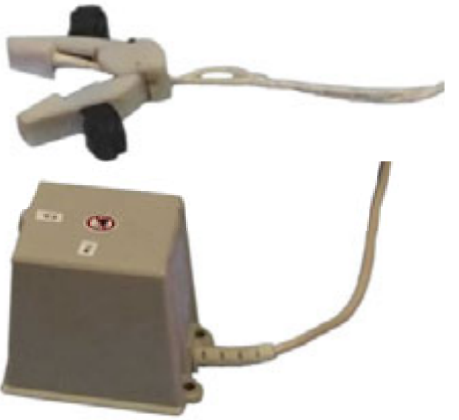
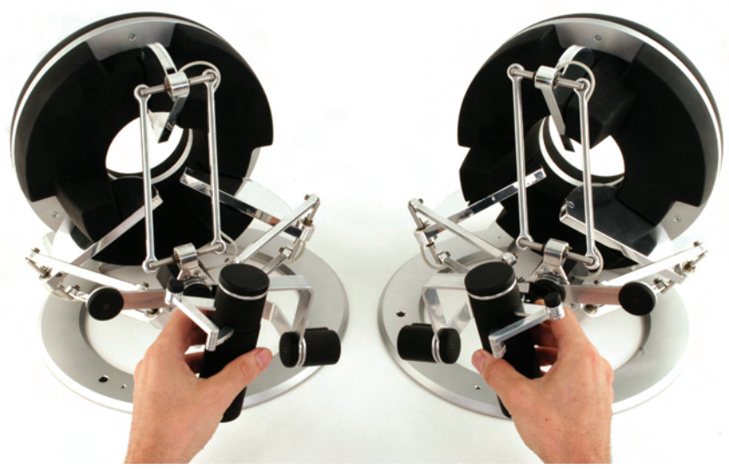
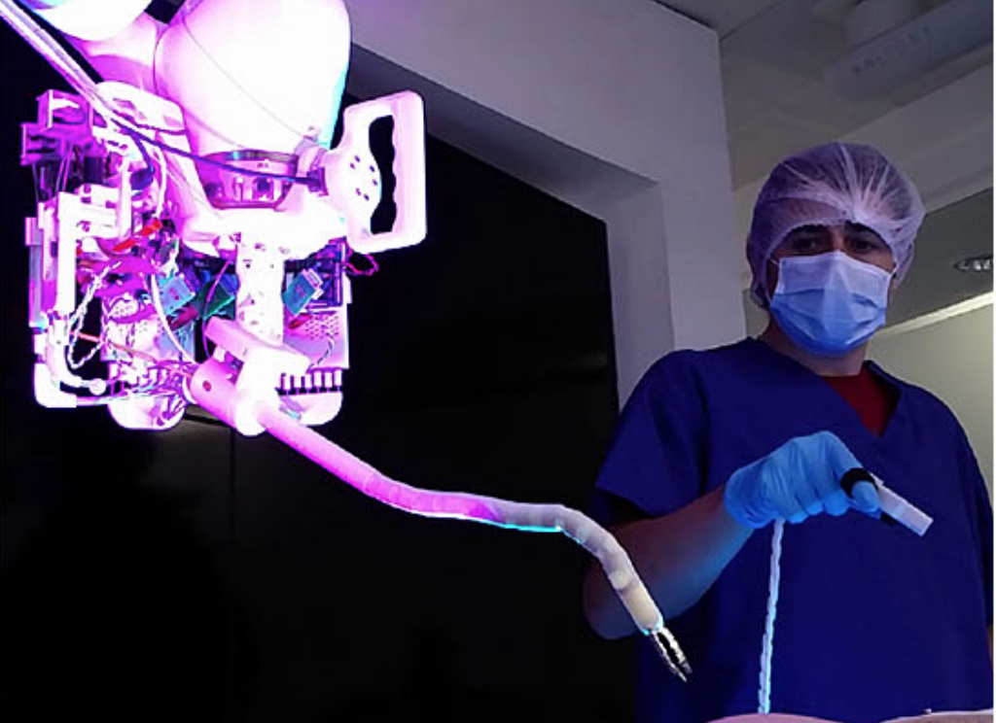
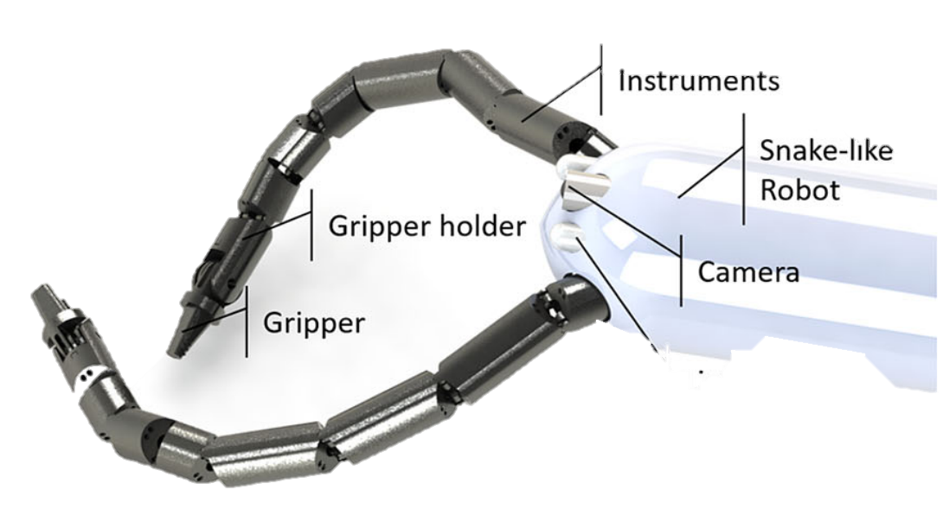
Literature Reviews(cont.)
Hamlyn Centre Previous Works
I²Snake robot system for Transoral Endoscopic Microsurgery
Oralarynx surgery
 | Oculus Rift | TrakSTAR Interface | Parallel Master Controller
Type | Ungrounded Controller | Ungrounded Controller | Grounded Controller, Stationary
Kinematic | Position and Orientation relative movement | Position and Orientation absolute movement | Position and Orientation relative movement
Workspace | - Open Workspace - limited by line of sight - Require Clutching | - Open Workspace - interfere by the ferromagnetic - No Clutching require | - Constrained Workspace - Clutching requires
Dynamics | - Only Vibration - No Kinaesthetic feedback | - No Vibration - No Kinaesthetic Feedback | - No Vibration - Haptic Feedback
Weights | Lightweight | Very lightweight | High weight
Wiring | Wireless Communication | Wire Connection | Mechanical Linkage
Global Positioning | Clutching | Absolute Control | Clutching
I²Snake – Kuka Robot 7 DOFs Instrument
I²Snake – Kuka Robot Dual 7 DOFs Instrument2

Slide 11
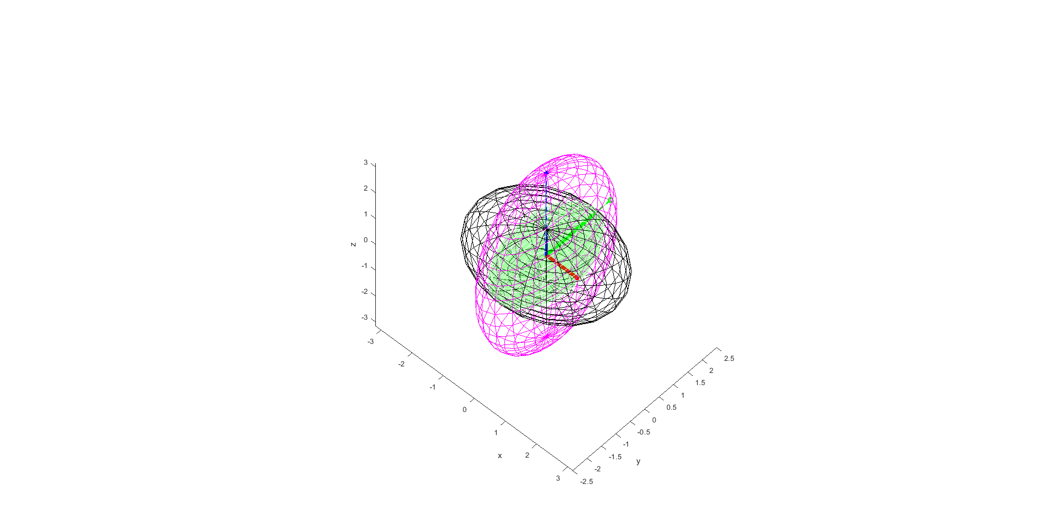
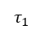
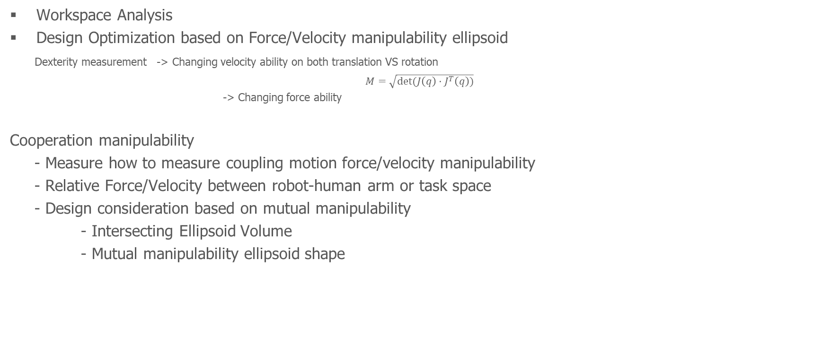
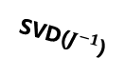
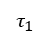
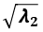
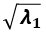
Material & Methods
Workspace Analysis
Design Optimization based on Force/Velocity manipulability ellipsoid
Dexterity measurement -> Changing velocity ability on both translation VS rotation
$M=\sqrt{det⁡(J\left(q\right)⋅J^{T}\left(q\right))}$
-> Changing force ability
Cooperation manipulability
- Measure how to measure coupling motion force/velocity manipulability
- Relative Force/Velocity between robot-human arm or task space
- Design consideration based on mutual manipulability
- Intersecting Ellipsoid Volume
- Mutual manipulability ellipsoid shape
Can move a lot in this direction
SVD(J)
V1
$$\sqrt{λ_{1}}$$
$$\sqrt{λ_{2}}$$
V2
Can’t move much in this direction
Velocity Ellipsoid
SVD($J^{−1}$)
$$τ_{1}$$
$$\sqrt{σ_{1}}$$
$$\sqrt{σ_{2}}$$
Force Ellipsoid
$$τ_{1}$$
Cooperation Manipulability (Intersection Ellipsoid
Manipulability Ellipsoid of Robot2
Manipulability Ellipsoid of Robot1

Slide 12
Material & Methods(cont.)
Haptic Control
Impedance control(Instrument)/Admittance control(Robot)/Hybrid control(Instrument+Robot)
Shared control
Transparency Design approach
Gravity compensation
Frictionless
High fidelity
Isotropic Manipulability
Auxiliary and shared control algorithm for continuum robot control
System Integration & Validation

Slide 13
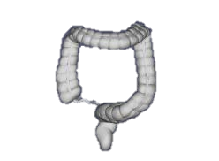
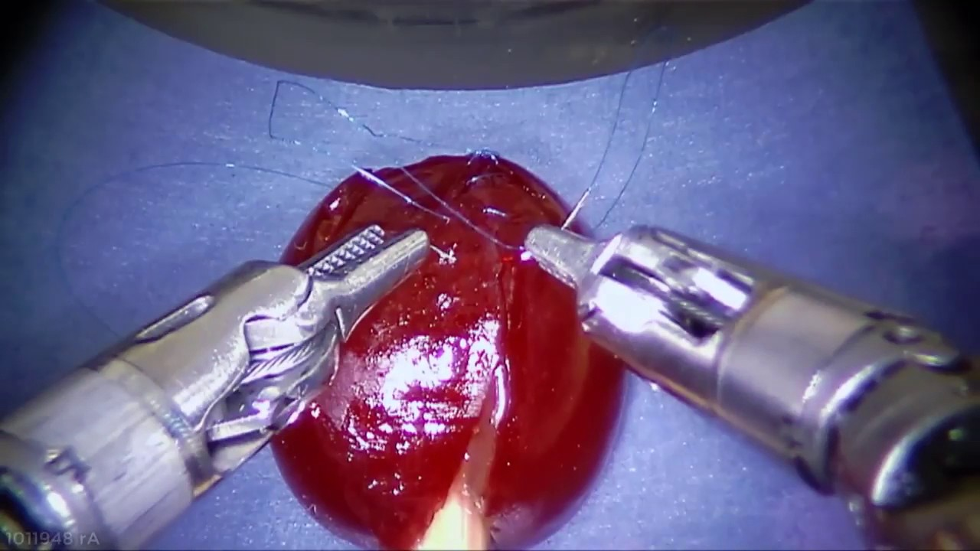
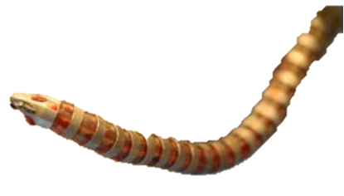
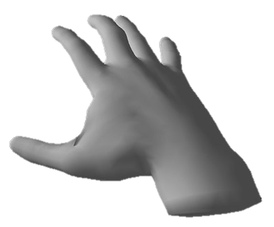
Expected Outcome
Robot Model Control Global View (Augmented Reality)
Robot First Person View
Steerable Section
Robot-Tissue Force interaction
Hand-Robot Force Interaction
Instrument Only
Surgical Manipulation
Fixed Camera view
Instrument + Robot
Combined Force(Instrument + Robot)
Whole manipulator control
Alter Camera View
Autonomously Path Following
Robot Only
Navigation Exploration
Pan/Tilt + FWD/BWD
Object Motion Compensation
Curvilinear Shape Control

Slide 14
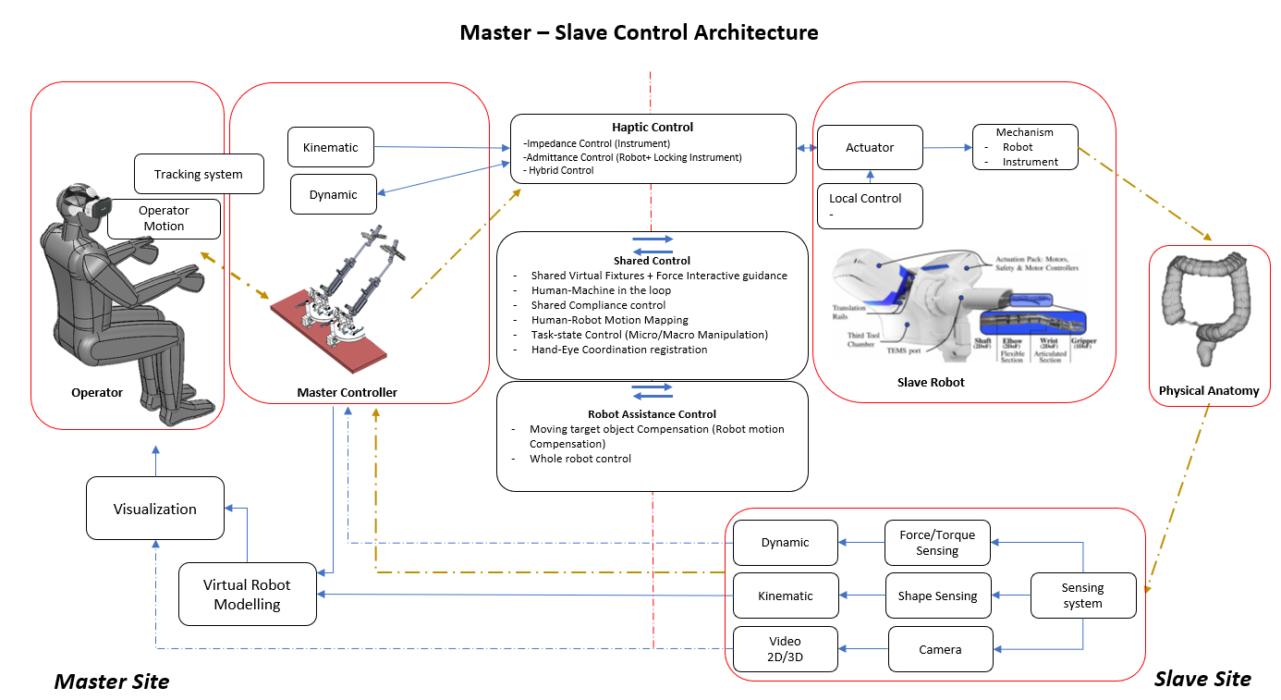
Expected Outcome

